Slide 1



SOCIAL MEDIA AND WEB ANALYTICS
Presented by:
Viktor, Wouter, Bert, Konstantin, Guillaume and Artur

Slide 2



Targeting
Assignment 1

Slide 3

Assignment 1 - Targeting
Outline
Extracting followers and their followers
Computing the ground truth
Spearman correlation ground truth and rank in different subsets
Determine optimal cut off point
Conclusion

Slide 4

Extracting the followers and their followers
@Viktor_vdb2
144 followers
- 21 private followers
= 123 followers
- 3 followers with more than 5000 followers
= 120 followers

Slide 5
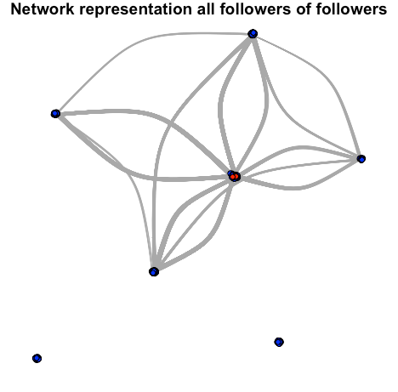
Network representation all followers of followers

Slide 6
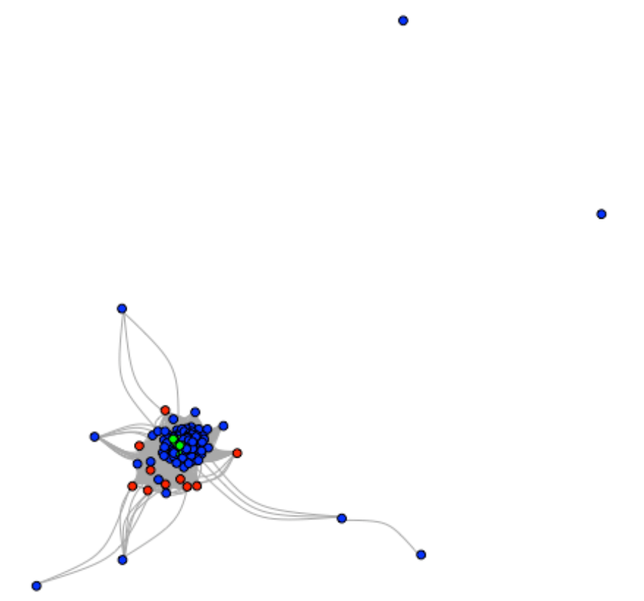

Network representation first degree followers

Slide 7
Compute ground truth
Computing the ground truth
3 methods
Dot product
A = X*X^T with X = document by term matrix
Users of interest
Euclidean distance
The distance between two users in a network
The smaller the distance, the closer the users are to each other in the network
Cosine similarity
Indicates similarity between users

Slide 8
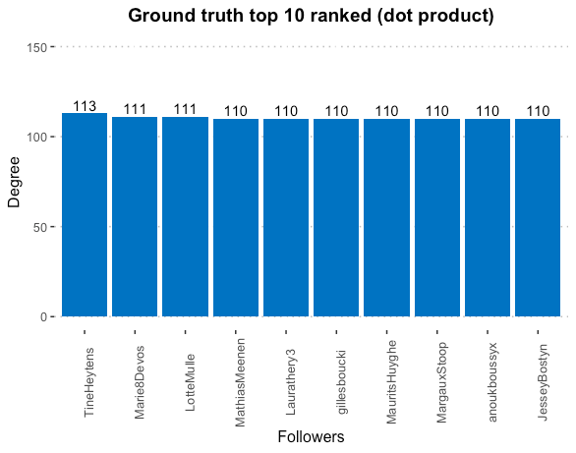
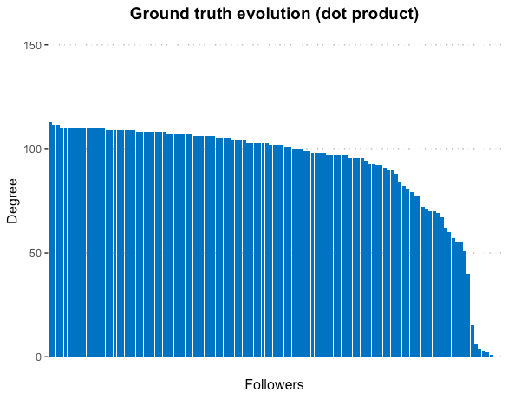
Dot Product

Slide 9
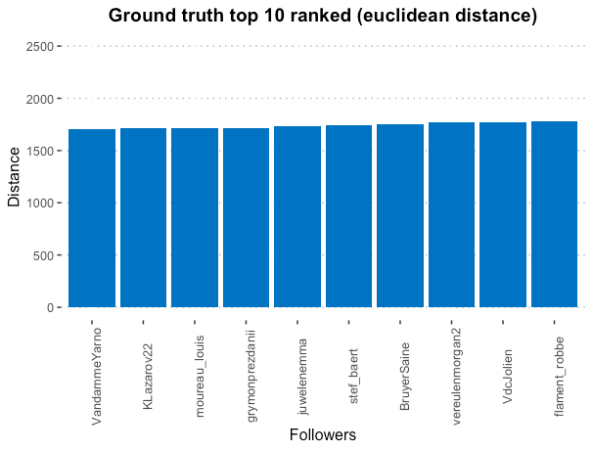
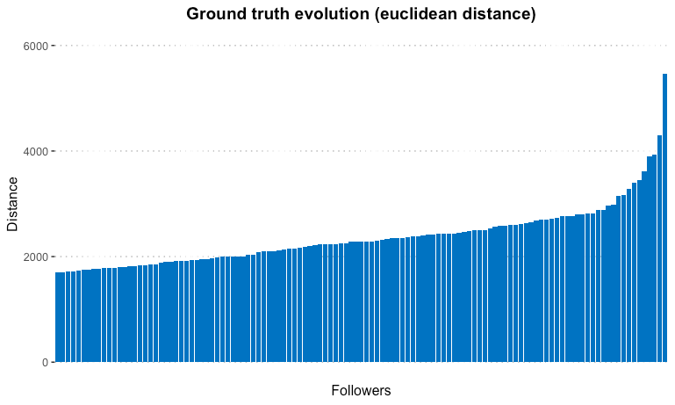
Euclidean distance

Slide 10
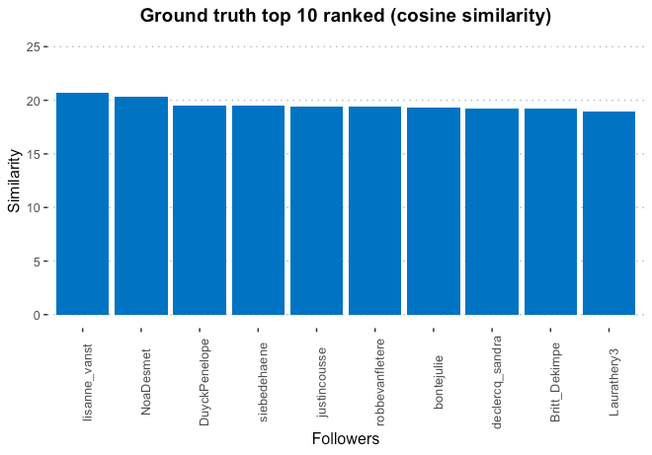
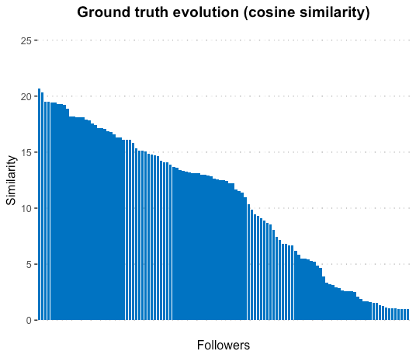
Cosine similarity

Slide 11
Ground truth approximation
Calculate Spearman correlation ground truth and different subsets
Method 1
Adjacency matrices with 2 to 5000 columns
Issue: ony the 5000 first columns could be chosen, this could create a bias
Method 2
Draw from 2 up untill 5000 columns from our entire matrix
Perform 5 times and take average per network size

Slide 12
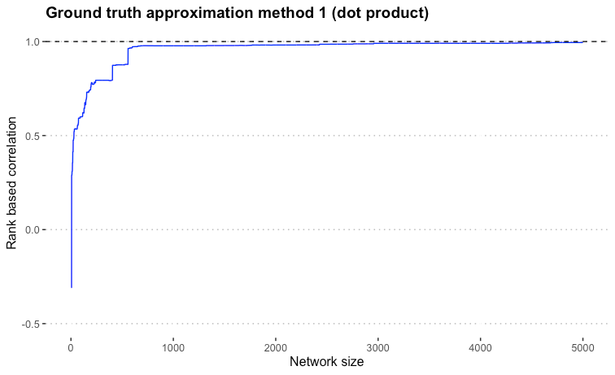
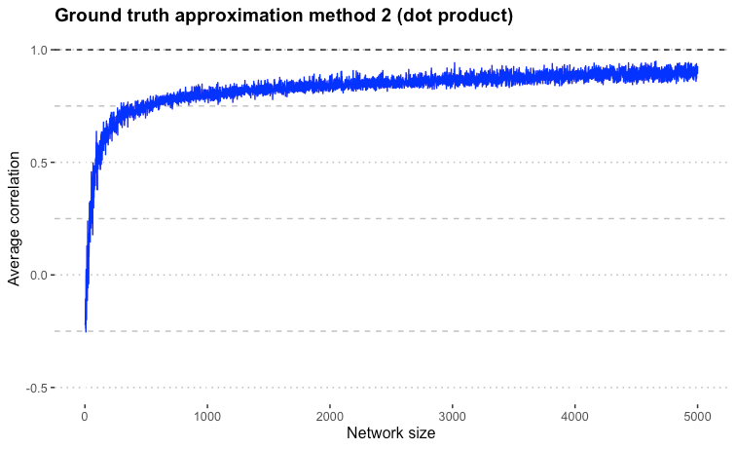
Dot Product

Slide 13
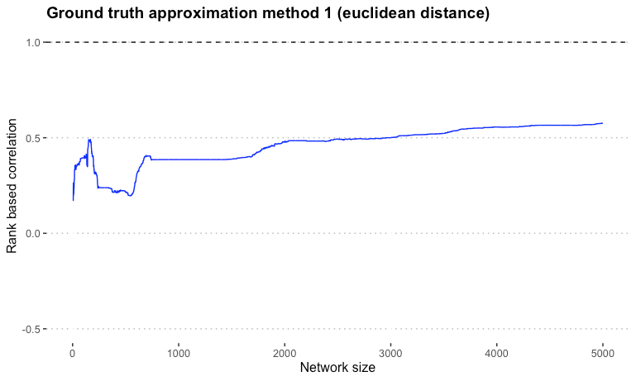
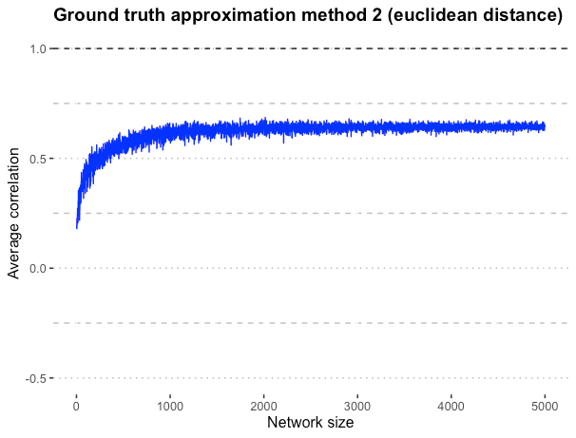
Euclidean distance

Slide 14
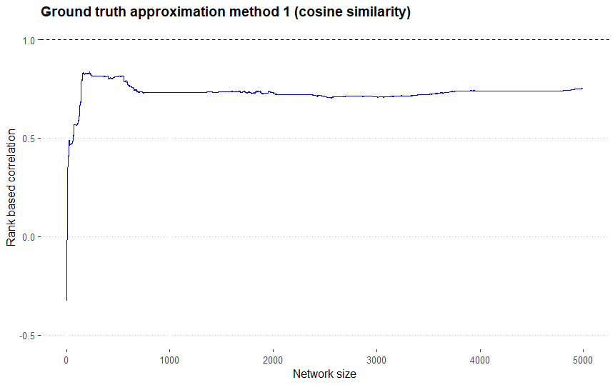
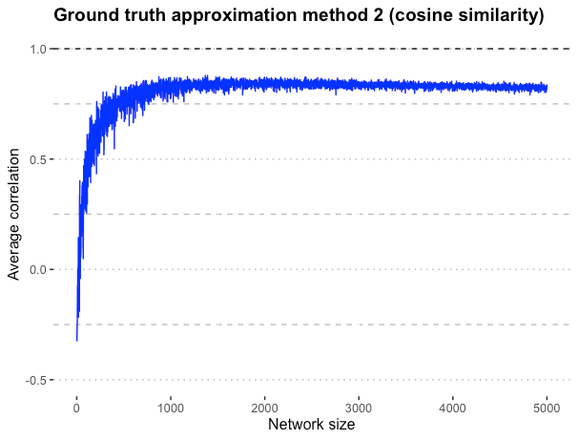
Cosine similarity

Slide 15
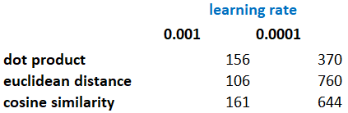
Optimal cut off point
Look at the learning rate of the average correlation for an increasing number of network size
Use smooth spline method to smooth the average correlation

Slide 16
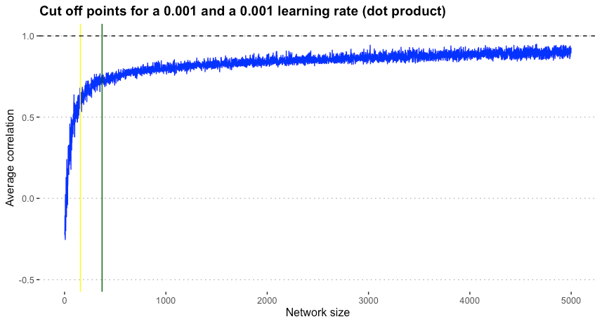
Dot Product

Slide 17
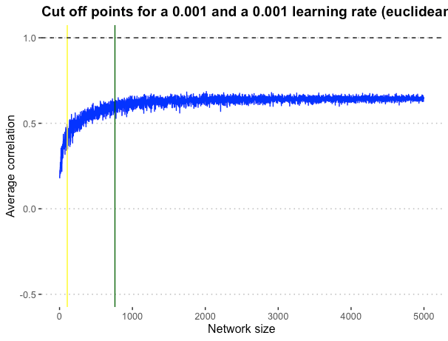
Euclidean distance

Slide 18
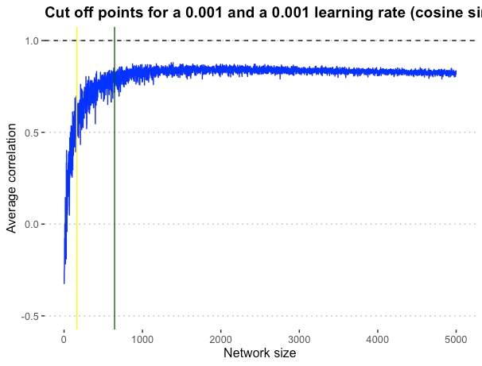
Cosine similarity

Slide 19
Conclusion
Dot product is the preffered method
The optimal number of followers to extract lies between 156 and 370

Slide 20


Performance
Assignment 2

Slide 21
Assignment 2 - Performance
Outline
Descriptive
Predictive
Wordclouds
Data Collection
Topic modelling
Data Preprocessing
Word embeddings
Modeling
Word networks
Sentiment analysis
Evaluation and deployment

Slide 22
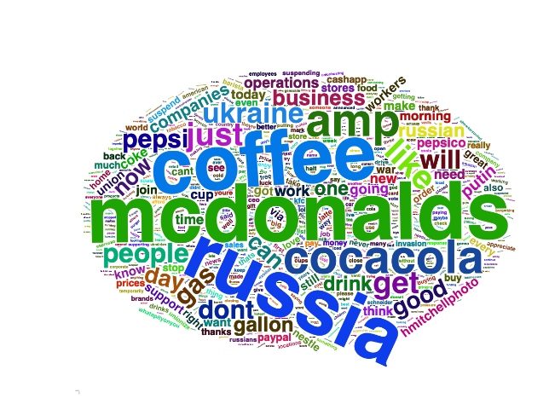
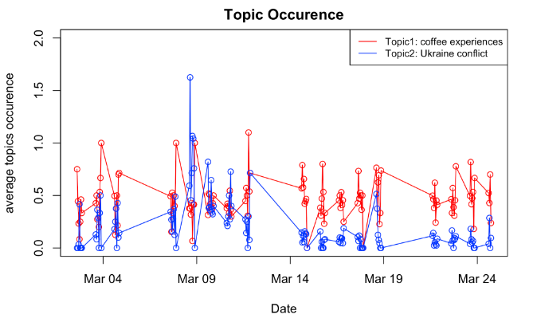
Descriptive
Word cloud
Topic counts aggregated per day

Slide 23
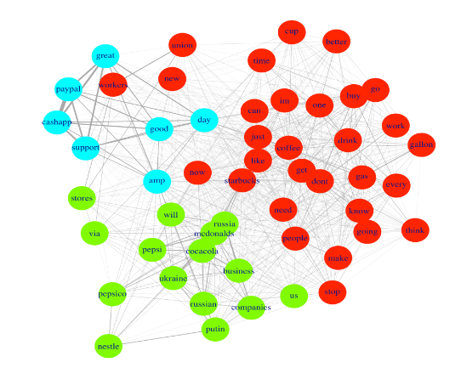
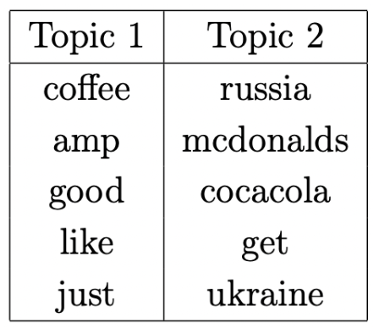

Descriptive
Word network
Topic table

Slide 24
Descriptive
Word embeddings:
highest cosine similarity with "russia"
word | cosine similarity
cocacola | 0.8065444
business | 0.8042734
mcdonalds | 0.7958537
operations | 0.7529080
companies | 0.7246531
pepsi | 0.7050898
ukraine | 0.6946635

Slide 25
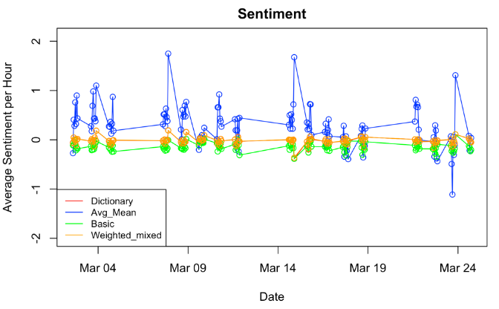
Descriptive
Sentiment values aggregated per day before scaling

Slide 26
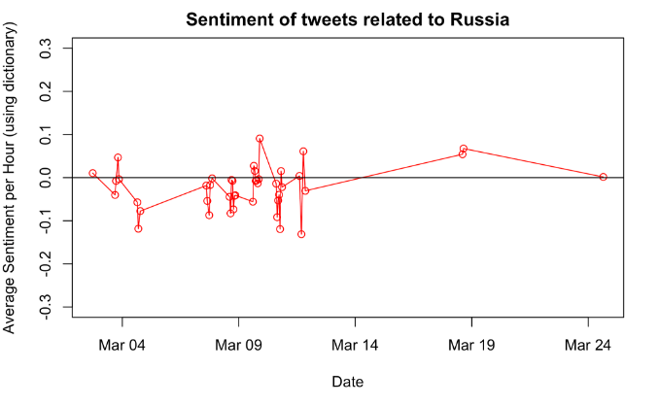
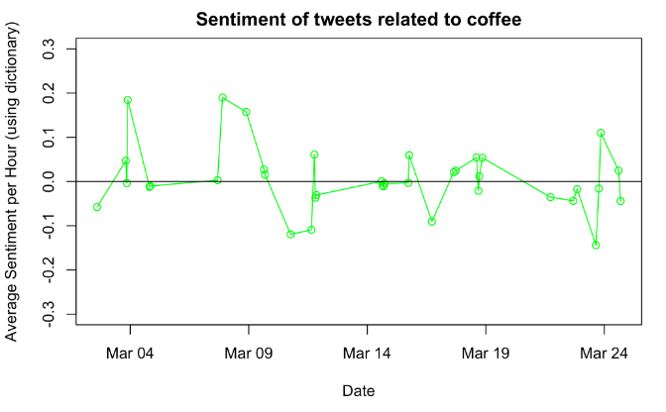
Descriptive
Sentiment of tweets related to ...
Russia
Coffee

Slide 27

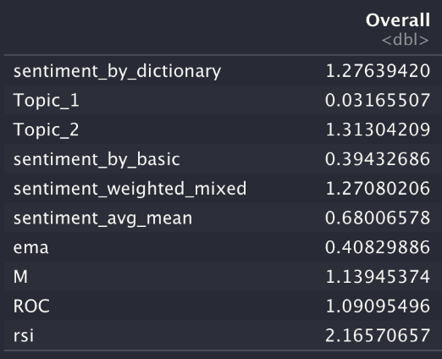
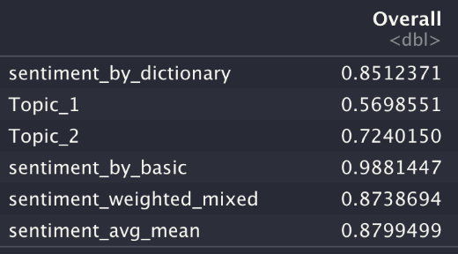
Predictive
Variable importance full model
Variable importance Twitter model

Slide 28
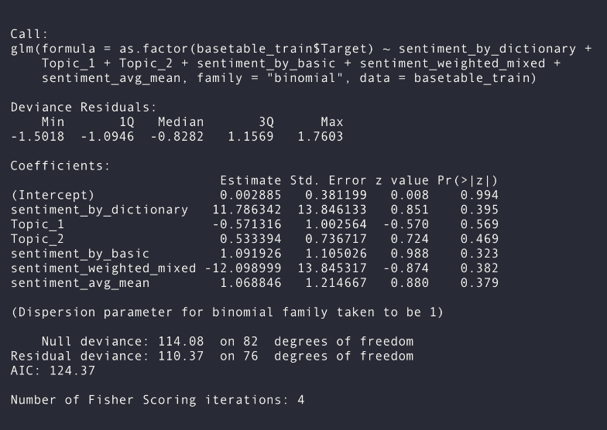
Predictive
Summary Twitter model

Slide 29
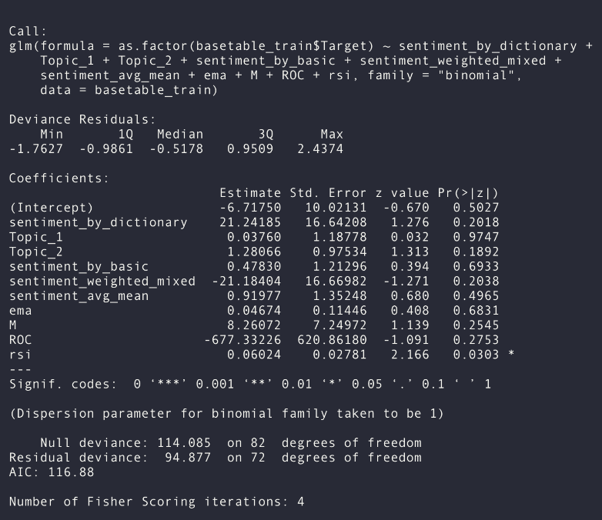
Predictive
Summary Full model

Slide 30
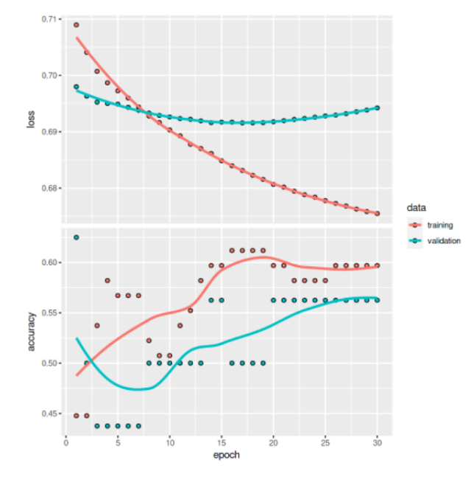
Predictive
Learning curves
neural network

Slide 31
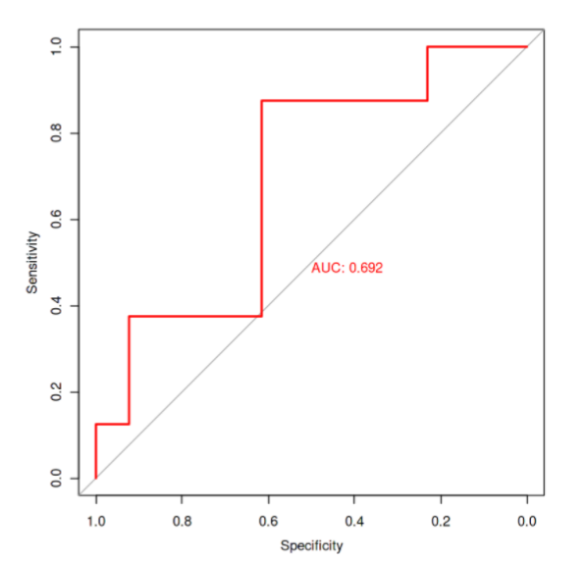
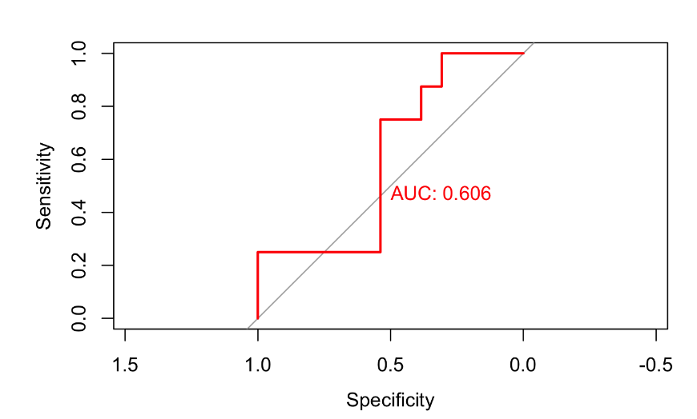
Predictive - evaluation
ROC Curve neural network
ROC curve Twitter model

Slide 32
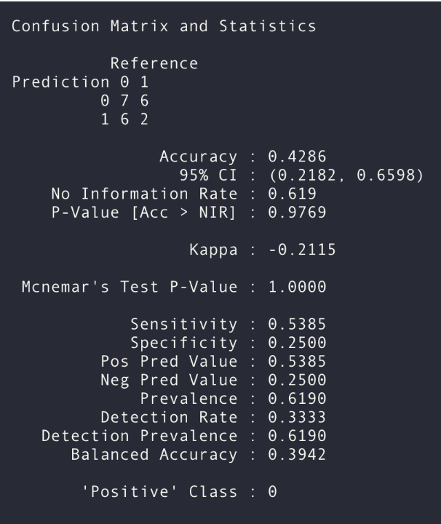
Predictive - evaluation
Confusion matrix Twitter model

Slide 33


Thank you!
Feel free to approach us if you have any questions.

